Slide 1
Graph Yourself!
Elizabeth Pozzulo

Slide 2
Goals
Objectives
The student will learn how to graph a line when presented with a linear equation.
The student will learn how to determine which lines will have steeper slopes.
Given an equation of a line in the form y=mx+b, the student will graph 5 consecutive lines correctly.
Given two linear equation in the form y=mx+b, the student will correctly state which one will have a steeper slope 5 consecutive times.

Slide 3
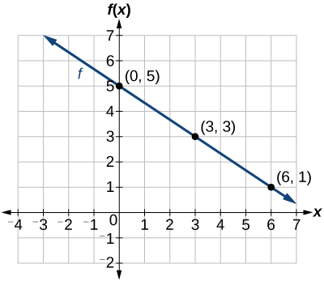
Prerequisite Skills:
Which point goes first when graphing
x-axis
y-axis
y=mx+b

Slide 4
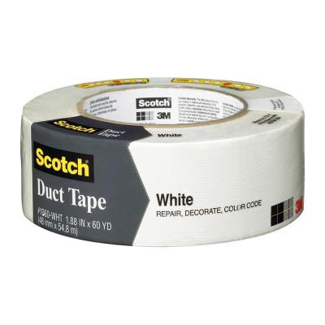
Materials:
Duct tape (any color)
Worksheet
It would be helpful to do this activity on a tile floor or find a way to make straight lines

Slide 5
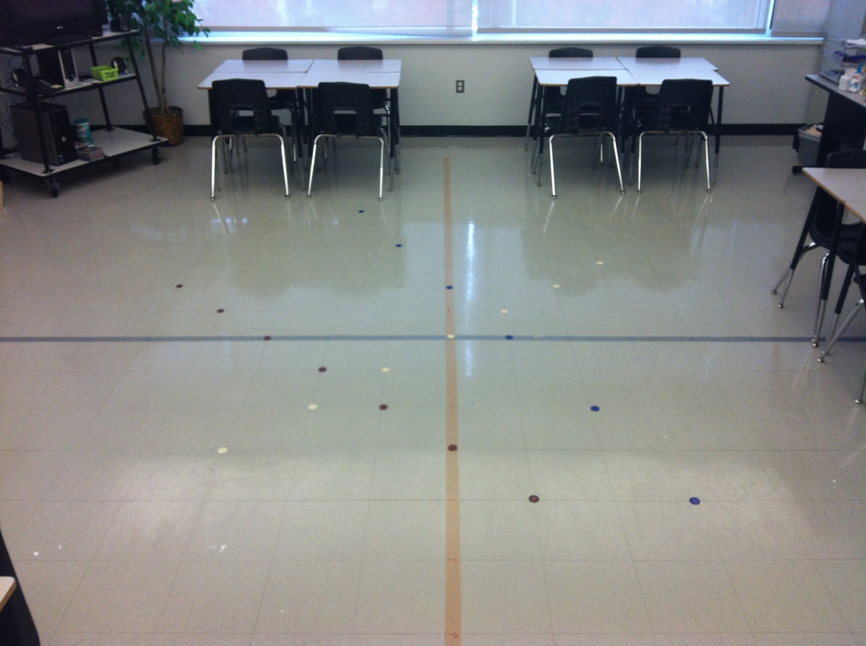
Simple Set Up!
Put two pieces of tape on the floor (one for the x-axis and one for the y-axis.
Label the x-axis
Label the y-axis

Slide 6
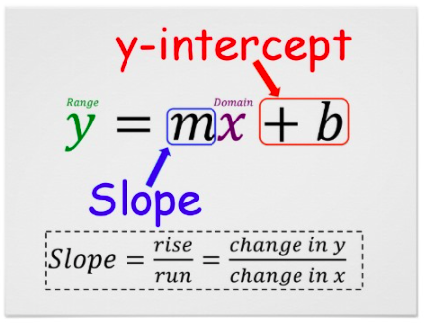
Step One:
Find the y-intercept
Choose one student to graph themselves on that point

Slide 7
Step Two:
Determine the slope
Choose at least 2 more students to graph themselves (while the other student is still there)

Slide 8
Step Three:
Repeat this process multiple times
Have the students determine which graphs have steeper lines
After a two or three examples, have them compare two equations and predict which one would produce a steeper line

Slide 9
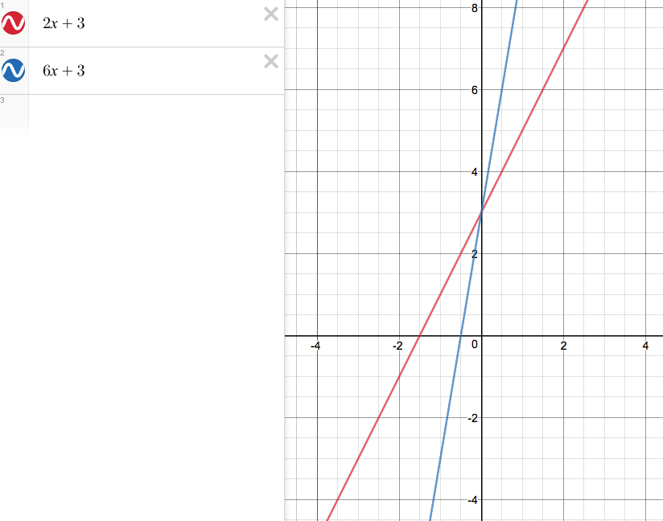

Slide 10
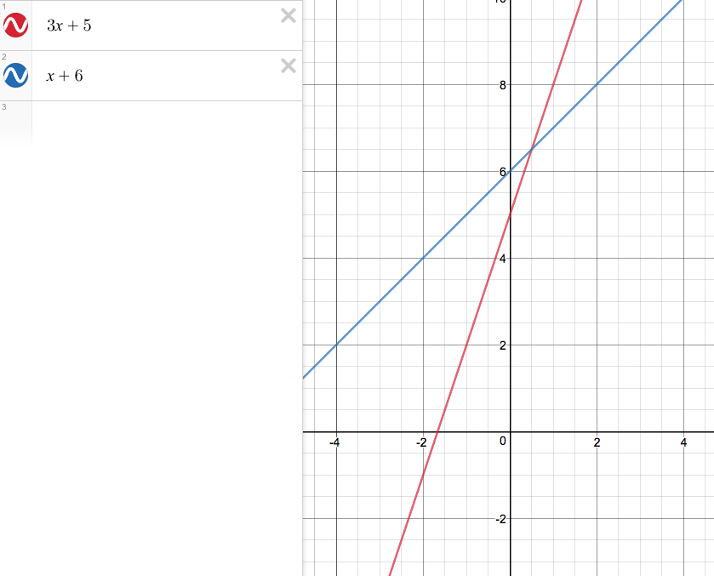

Slide 11
References
Graphing Linear Equations - Full Body Style. (n.d.). Retrieved May 01, 2017, from https://www.teachingchannel.org/videos/graphing-linear-equations-lesson

